Slide 1
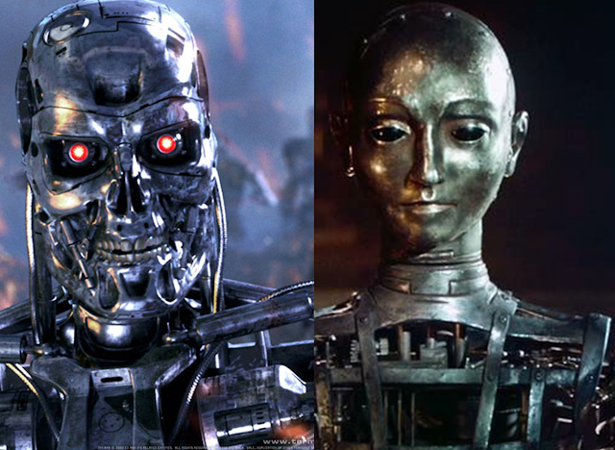
Theory Of Automata
1
Notes:
<number>

Slide 2
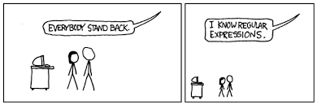
Lecture # ….
Theory of Automata
2

Slide 3
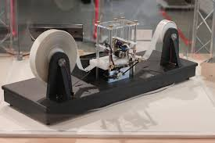
REGULAR GRAMMAR
3

Slide 4
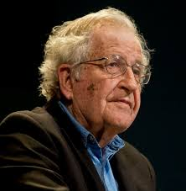
Regular Grammar
In 1956, Noam Chomsky gave a mathematical model of grammar ,which is effective for writing computer language.
According to this model, there are basically
four types of languages
3

Slide 5
Chomsky Hierarchy
According to Chomsky hierarchy,
Type 0 known as unrestricted grammar.
Type 1 known as context sensitive grammar.
Type 2 known as context free grammar.
Type 3 Regular Grammar.
3

Slide 6
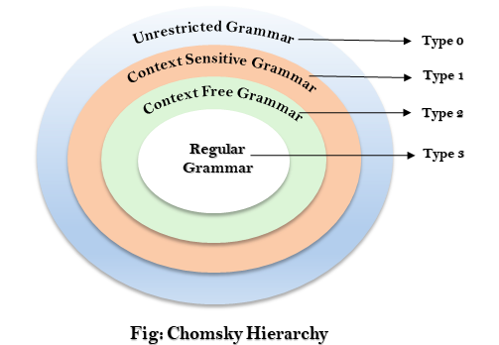
Chomsky Hierarchy
3

Slide 7
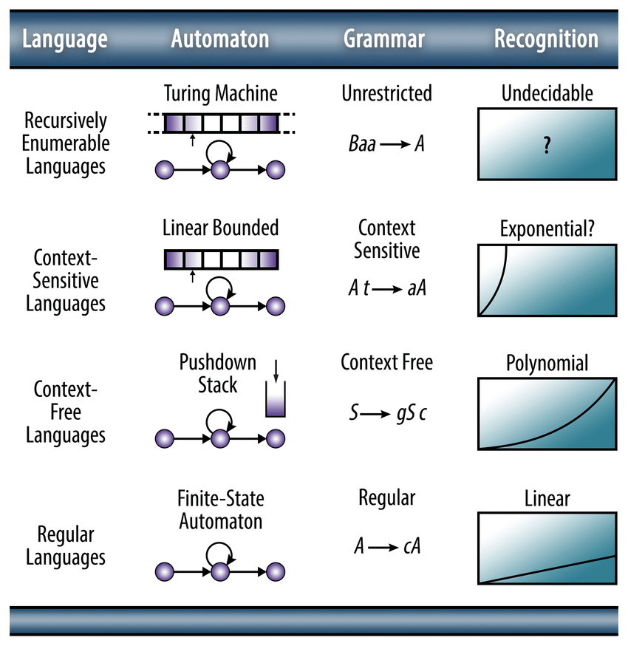

Slide 8
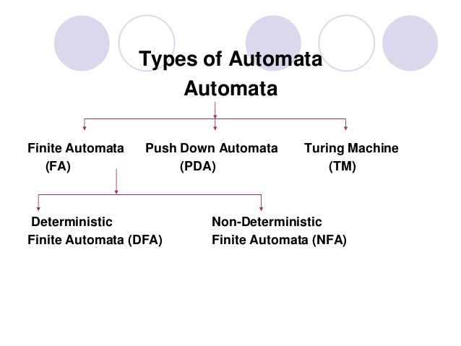
3

Slide 9
Definition of Grammar
•A Grammar ‘G’ can be formally described using 4 tuples as
G = ( V, T, S, P)
Where,
V: Set of variables / Non terminal symbols
T: Set of terminal symbols
S: Start variable
P: Set of Production rules (for terminal and non terminal symbols)
3

Slide 10
A Simple Grammar
•Grammar: S → aSb
S → λ
•Derivation of sentence: ab
S → aSb
Since S→ λ
S → aλb
S → ab
(Note: There are so many strings that can be derived from above mentioned grammar )
3

Slide 11
Example of Grammar Notation
•Grammar: S → aSb
S → λ
•G = ( V, T, S, P)
V = {S}
T = {a,b}
S = {S}
P = {S → aSb , S → λ}
3

Slide 12
Driving Strings in the Grammar
•Grammar: S → aSb
S → λ
•Derivation of sentence: aabb
S → aSb
(Since S→ aSb)
S → aaSbb
(Moreover, S→ λ)
S → aaλbb
S → aabb
3

Slide 13
A Sentential Form
S → aSb (Sentential form)
S→ aaSbb (Sentential form)
S → aaaSbbb (Sentential form)
S → aaabbb (Sentence)
3

Slide 14
A Linear Grammar
•A linear grammar is a context-free grammar that has at most one non-terminal / variable in the right hand side of each of its productions. (Having only λ or ɛ in the R.H.S also counts).
3

Slide 15
Right Linear Grammar
•A grammar is said to be right-linear , if all productions are of one of the forms .
A → xB
A → x
where,
A, B ∈ V and x ∈ T *
3

Slide 16
Left Linear Grammar
•A grammar is said to be left-linear if, all productions are of the form
A → Bx or
A → x
where,
A, B ∈ V and x ∈ T *
A regular grammar is one that is either left-linear or right-linear.
3

Slide 17
Derivation from a Grammar
•The set of all strings that can be derived from a grammar is said to be the Language from that Grammar
3

Slide 18
Examples
Q1: Consider the grammar
G1={(S,A),(a,b),S,(S→aAb,aA→aaAb,A→ ∈ )}
And derive the string aaabbb from this grammar.
S→aAb
3

Slide 19
Q2: Consider the grammar
G2={(S,A,B),(a,b),S,(S→AB,A→a,B→b )}
And show the language generated from this grammar.
S→AB
S→ab (Since , A=a and B=b)
The language generated from this grammar is ab.
Mathematically ,
L(G2) = {ab}
3

Slide 20
Q3: Consider the grammar
G3={(S,A,B) , (a,b) , S, (S → AB, A→ aA / a, B→ bB / b )}
And the language from this grammar.
L(G3)= {ab ,a²b , a²b² , ab²,…..}
•S→AB
S→ab (A=a ,B=b)
•S→AB
S→aAb (A=aA ,B=b)
S→aab (A=a)
3

Slide 21
Context Free Language
•In formal language theory, a context free language is a language generated by some Context Free Grammar.
•The set of all Context Free Language is identical to the set of languages accepted by Push Down Automata.
3

Slide 22
•Automata to design a Context Free Language is Push Down Automata.
•Automata to design a Regular Language is Finite State Automata.
•Context Free Languages are higher languages as compared to Regular Languages is Push Down Automata.
3

Slide 23
• Context Free Grammar is formally defined by the 4 tuples as
•G = { V, Σ, S, P}
Where,
V: Set of variables / Non terminal symbols
Σ: Set of terminal symbols
S: Start variable
P: Set of Production rules (which creates difference between PDA and FSM)
3

Slide 24
•Context Free Grammar , Production rules are in form of
A → α (A tends to /gives α)
where ,
α = {V U Σ} (α can be a terminal or non terminal or ε/null )
and
A € V (A belongs to Non terminal symbols)
3

Slide 25
Example
•For a generating a language that generates equal number of a’s and b’s in the form a^{n}b^{n} ,the Context Free Grammar will be defined as:
G = {(S,A),(a,b),(S →aAb, A→ aAb/ε)}
• a^{n}b^{n} = Number of a’s = Number of b’s
3

Slide 26
•Grammar: S → aAb
A → aAb / ε
•Derivation of sentence: a^{n}b^{n}
S → aAb
S → aaAbb ( Since A = aAb )
S → aaaAbbb ( Since A = aAb )
S → aaabbb ( Since A = ε )
a³b³ = a^{n}b^{n}
3

Slide 27
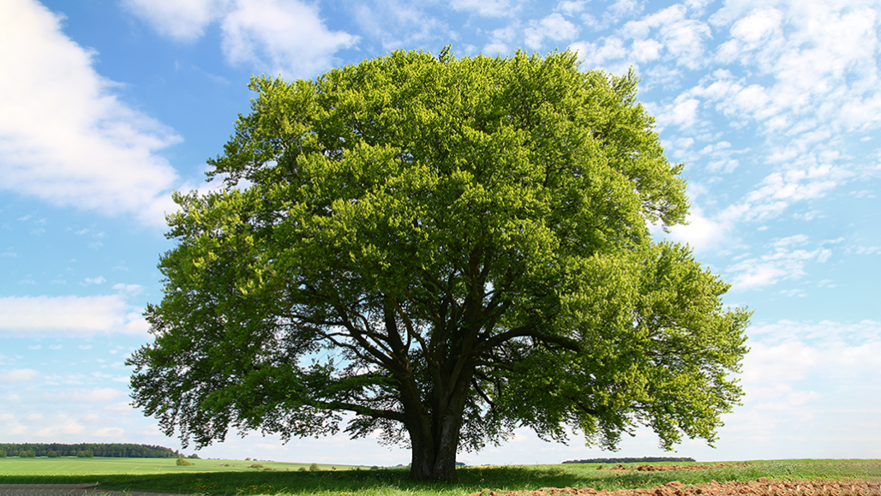
DERIVATIVE TREE
27

Slide 28
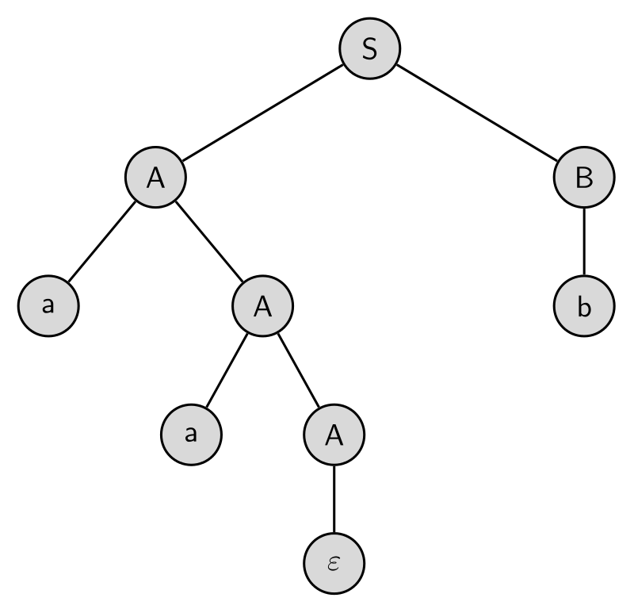
Derivative Tree
•A Derivative Tree or a Parse Tree is an ordered rooted tress that graphically represents the semantic information of strings derived from a Context Free Grammar
•The process of deriving a
string is called as
derivation.
27

Slide 29
•For the grammar G ={V , T , P , S}
S → 0B , A → 1AA|ε , B → 0AAA
•Root Vertex : Must be labeled by the start symbol.
•Vertex : Labeled by the Non-Terminal Symbol
•Leaves : Labeled by the Terminal Symbol or ε (no branches /no children)
(Note : the D.T for above mentioned grammar will be discussed in the class)
27

Slide 30
A Derivative Tree
27

Slide 31
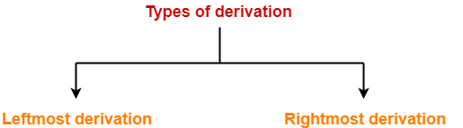

Slide 32
Left Derivative Tree
•A left derivative tree is obtained by applying production to the leftmost variable in each step.
• The process of deriving a string by expanding the leftmost non-terminal at each step is called as leftmost derivation.
<number>

Slide 33
Right Derivative Tree
•A rightmost derivation is obtained by applying production to the rightmost variable in each step.
• The process of deriving a string by expanding the rightmost non-terminal at each step is called as rightmost derivation.
<number>

Slide 34
•For the grammar G ={V , T , P , S}
S → aAS|aSS|ε , A → SbA|ba
•Derive the string aabaa using leftmost/rightmost derivative method.
<number>

Slide 35
•Construct a derivative tree for the string “bbabb” from the Context Free Grammar given by:
S → bSb|a |b, A
<number>

Slide 36
•Construct a derivative tree for the string “aabbabba” from the Context Free Grammar given by:
S → aB|bA
S → a|aS |bAA
S → b|bS|aBB
<number>

Slide 37
•Construct a derivative tree for the string “bbaababa” from the Context Free Grammar mentioned in the previous example
<number>

Slide 38
•Consider the grammar (mentioned below) and obtain its Derivative Tree
E → E + E
E → E * E
E → (E)
E → id
1: id * id + id
2: (id + id)* id
<number>

Slide 39
Grammar Ambiguity
•A string is derived ambiguously in Context Free Grammar ,if it has two or more different Parse Tree.
•A grammar is ambiguous , if it generates some string ambiguously.
<number>

